Slide 1





Al Delcy
Web Developer & Designer for the Marketing Team at ECOTECH VISIONS
Backend Rails Develloper
Front-End Web Developer at VIDEOREHEARSER
FREELANCE:
Photographer
Videographer
Certified Creative Crazy Person

Slide 2
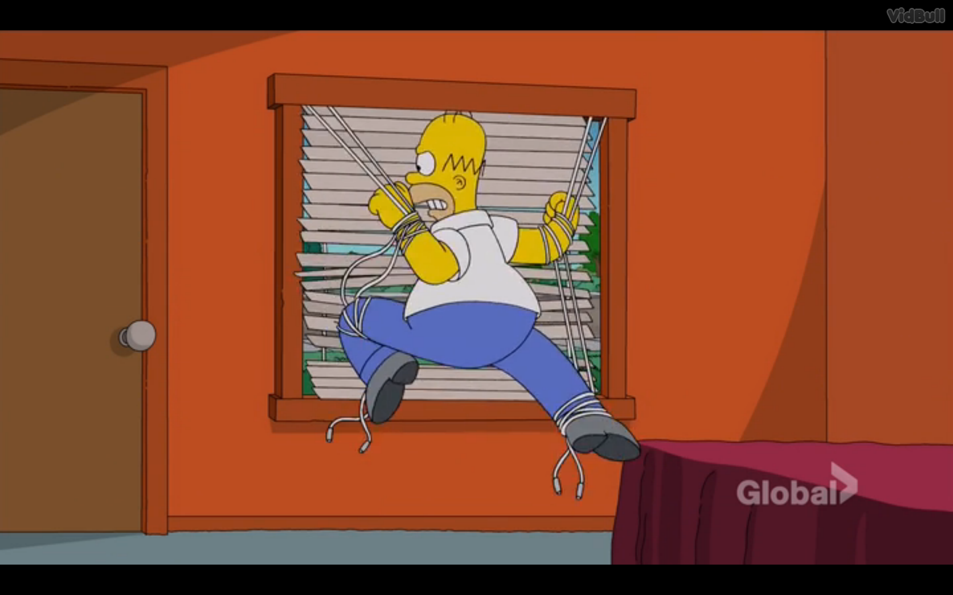
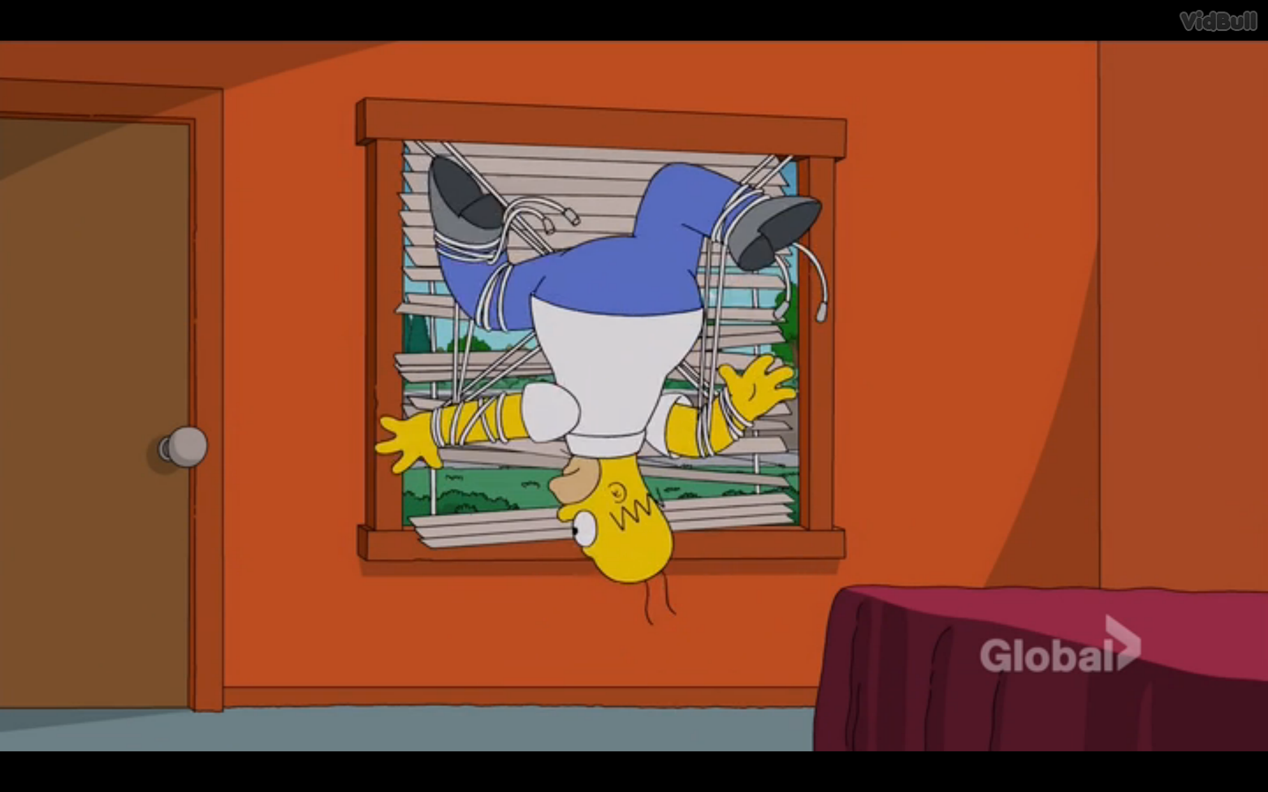
BONUS: Vertical Align with CSS

Slide 3
Intro to Graphic Design
Crash Course

Slide 4
just want to do your resume?
https://www.kickresume.com/

Slide 5
Front-end & Graphic Design
Front-end Devs who know the basics of design and photography software is a +
Become a well-rounded front end Developer and Designer
Reduce Back & Forth with graphic designer
Save Time & Money (Very Important)
Gain Bragging Rights ← Most important

Slide 6

Visual Software
Lots of them out there that do:
The same thing, online and on the computer
Combination of visual manipulation
Or more than that…
http://www.lifehack.org/articles/technology/the-10-best-photoshop-alternatives-you-need-know.html
Industry Standard:
ADOBE CREATIVE CLOUD (Adobe CC)
ADOBE CREATIVE SUITE (Adobe Cs)
Probably heard about it:
Pdf
Photoshop

Slide 7


Slide 8
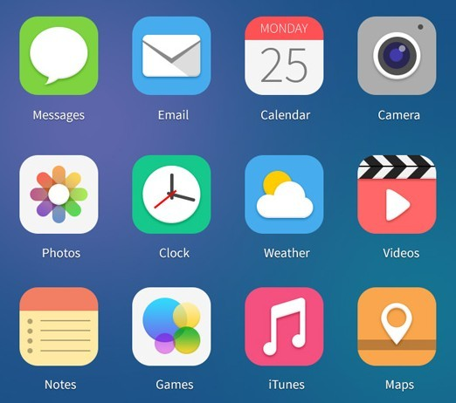
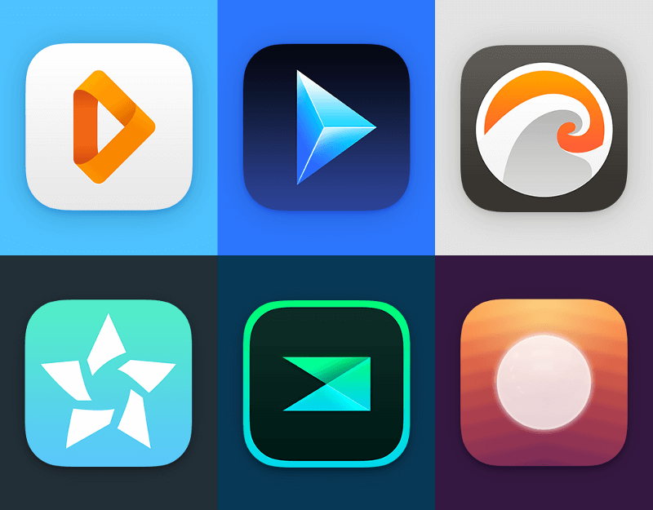

Slide 9
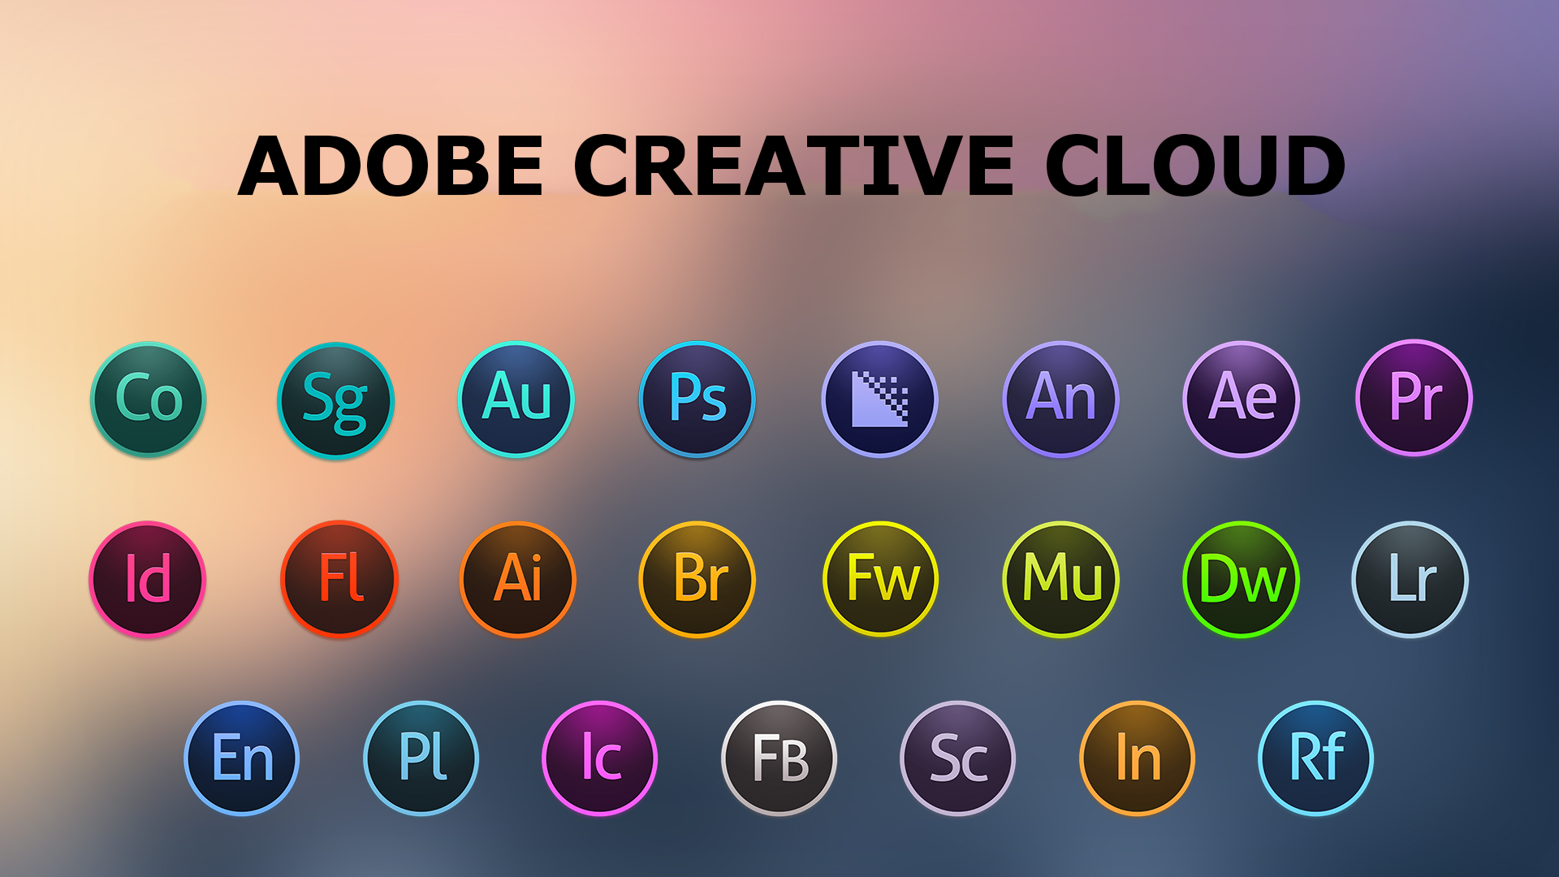

Slide 10
Photography
Graphic Design
Front end Dev

Slide 11


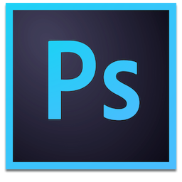
Illustrator
Lightroom
Photoshop

Slide 12
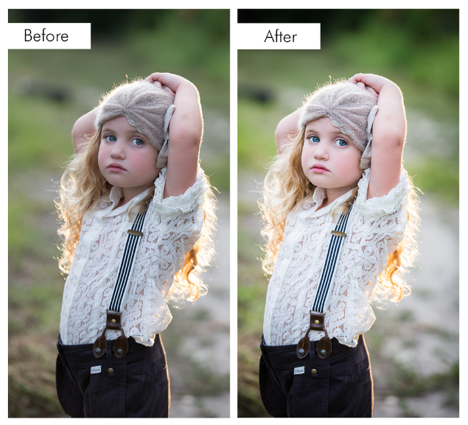

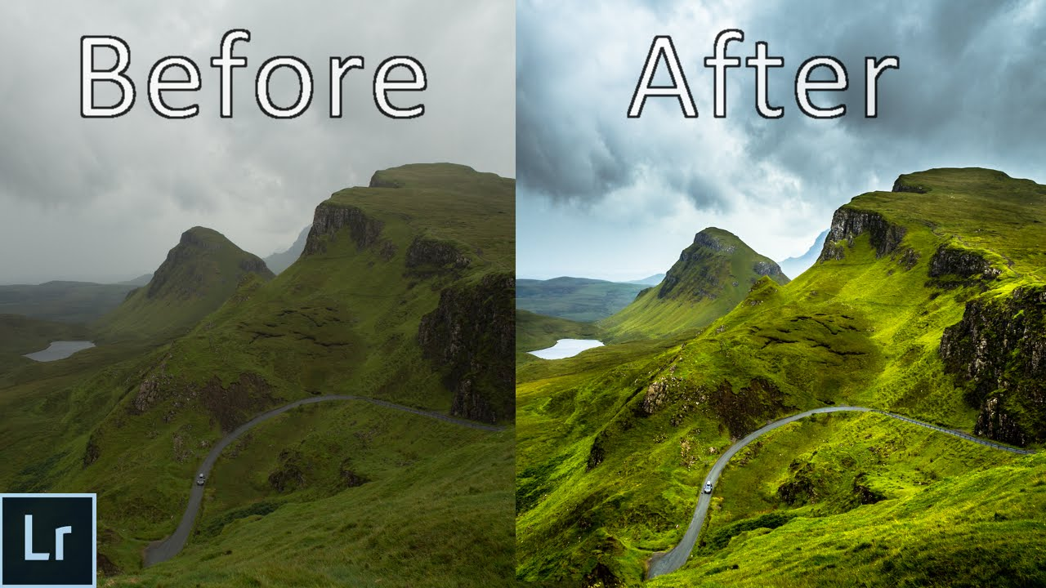
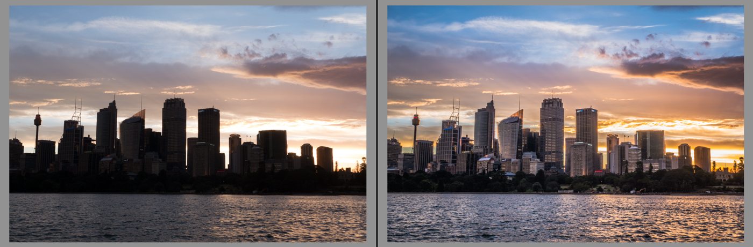
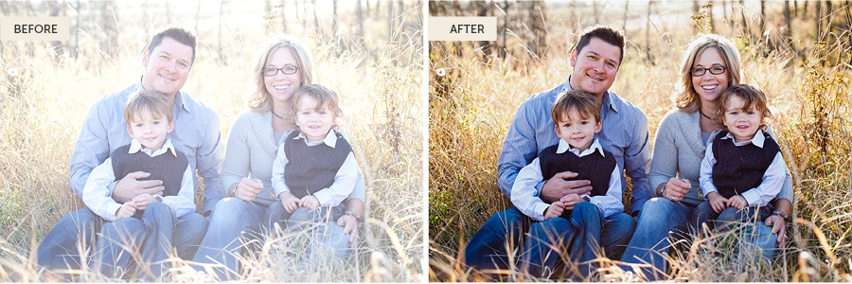
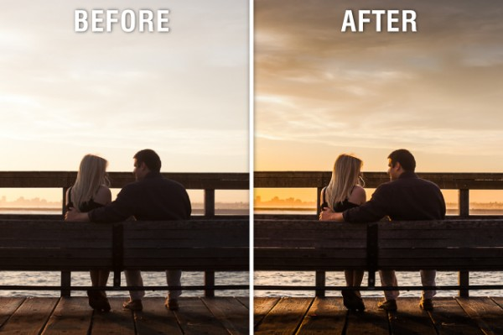



Slide 13
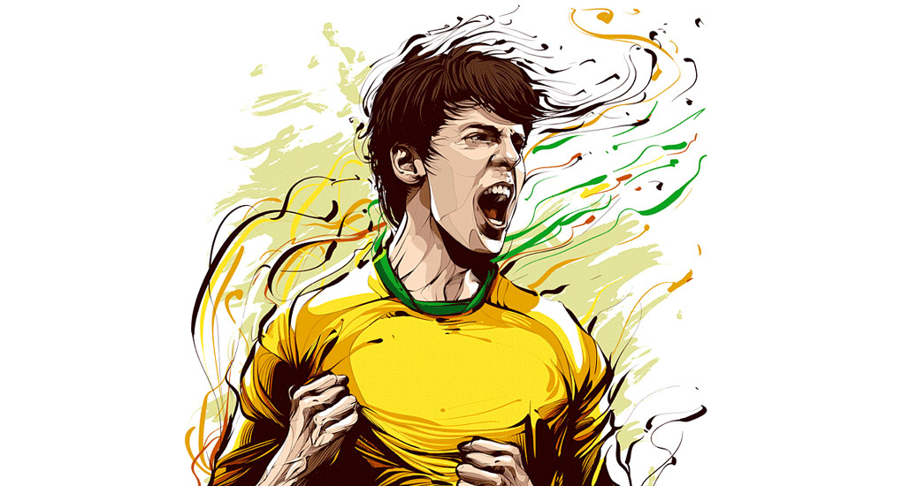
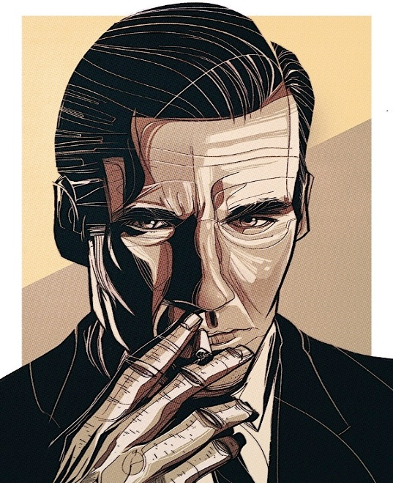
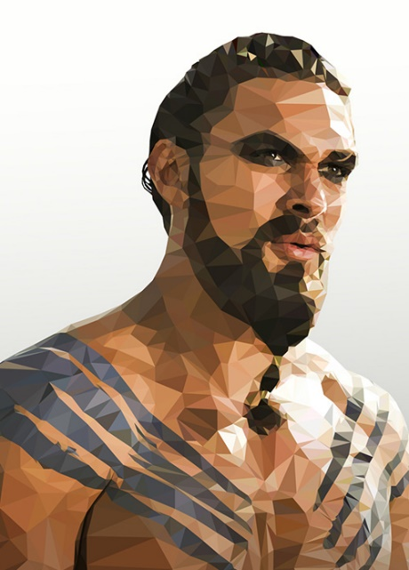


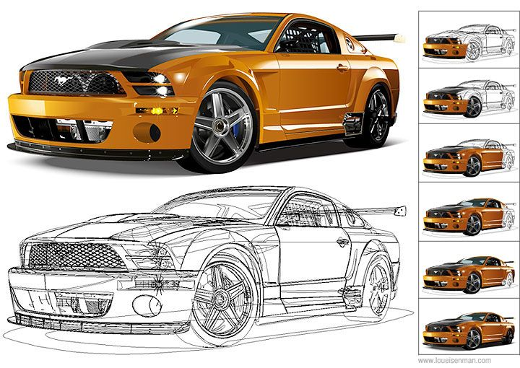




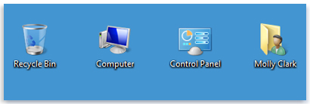


Slide 14
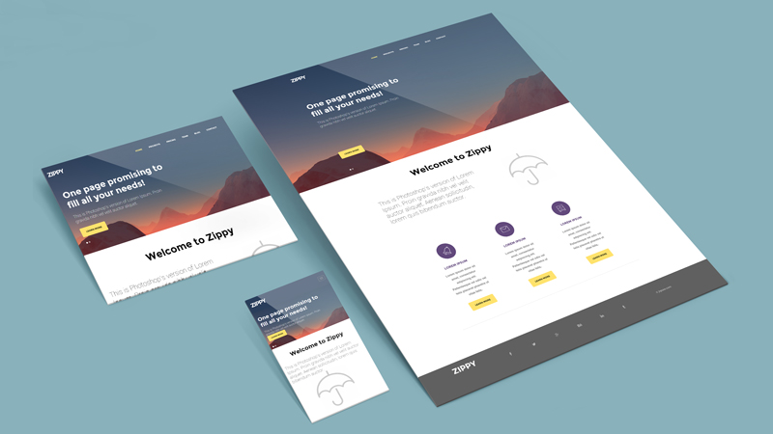
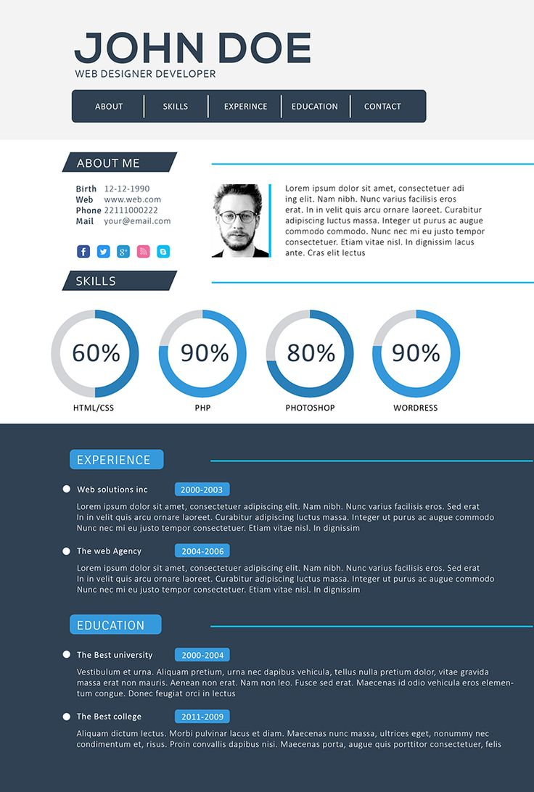
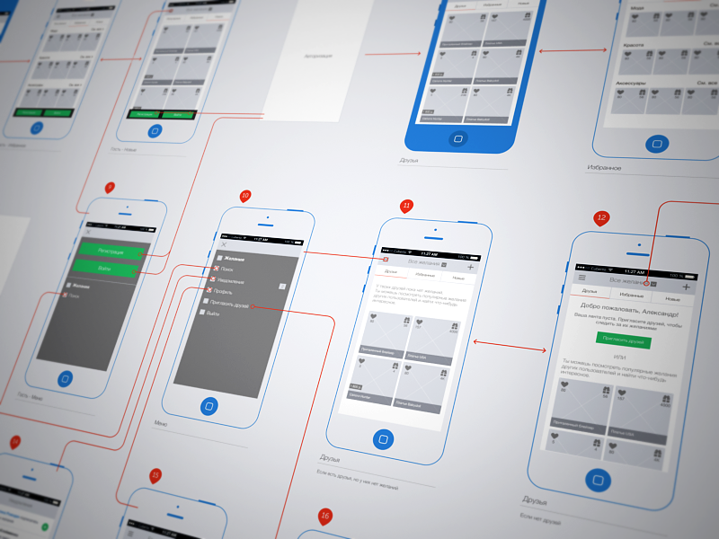
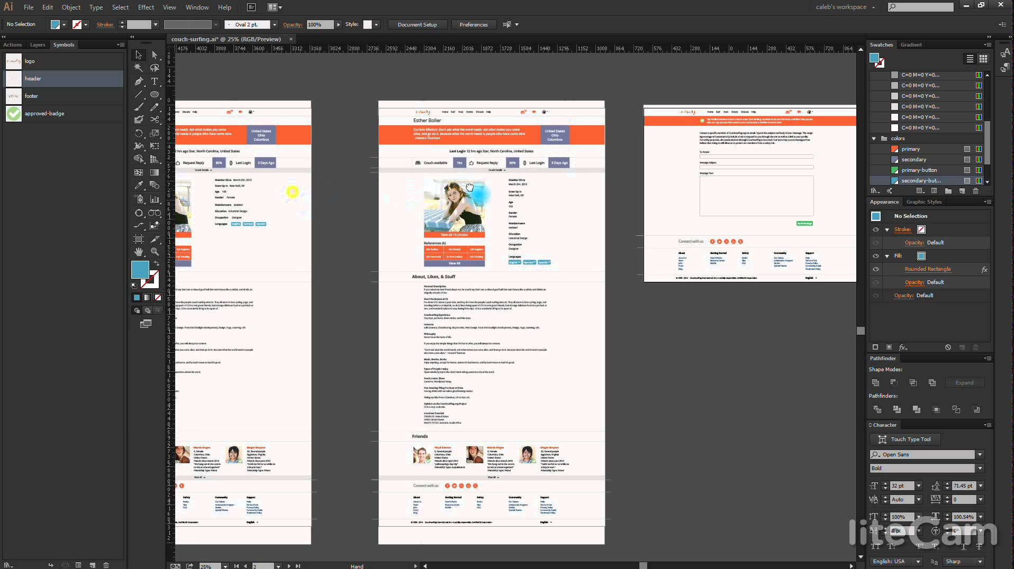

Slide 15
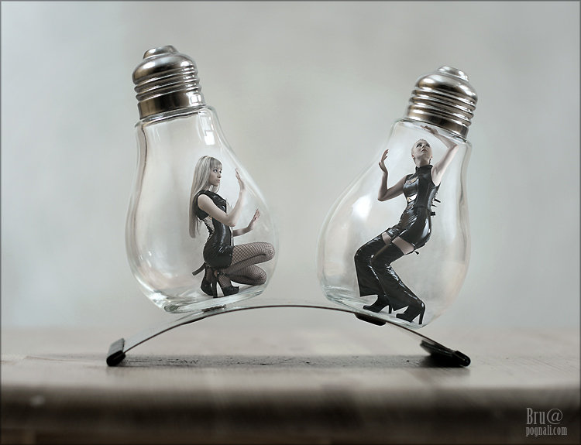

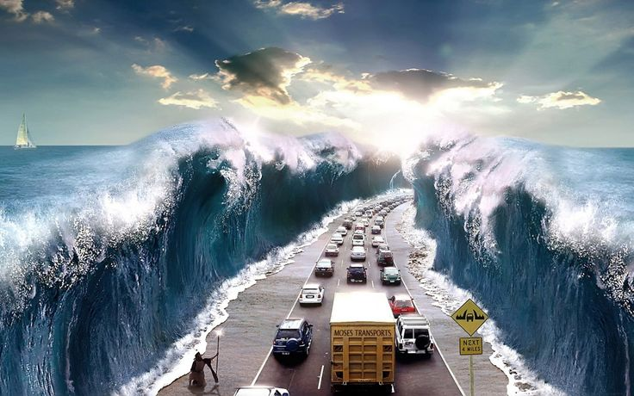

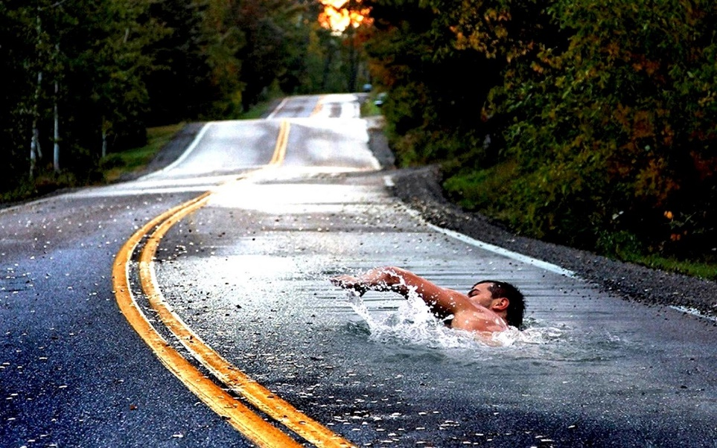
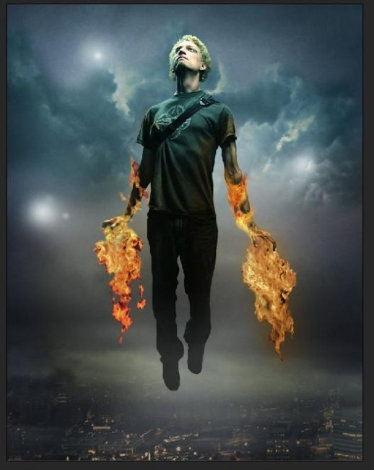
http://webneel.com/webneel/blog/25-creative-photo-manipulation-works-done-photoshop-awesome-collection

Slide 16
Illustrator
Lightroom
Photoshop

Slide 17
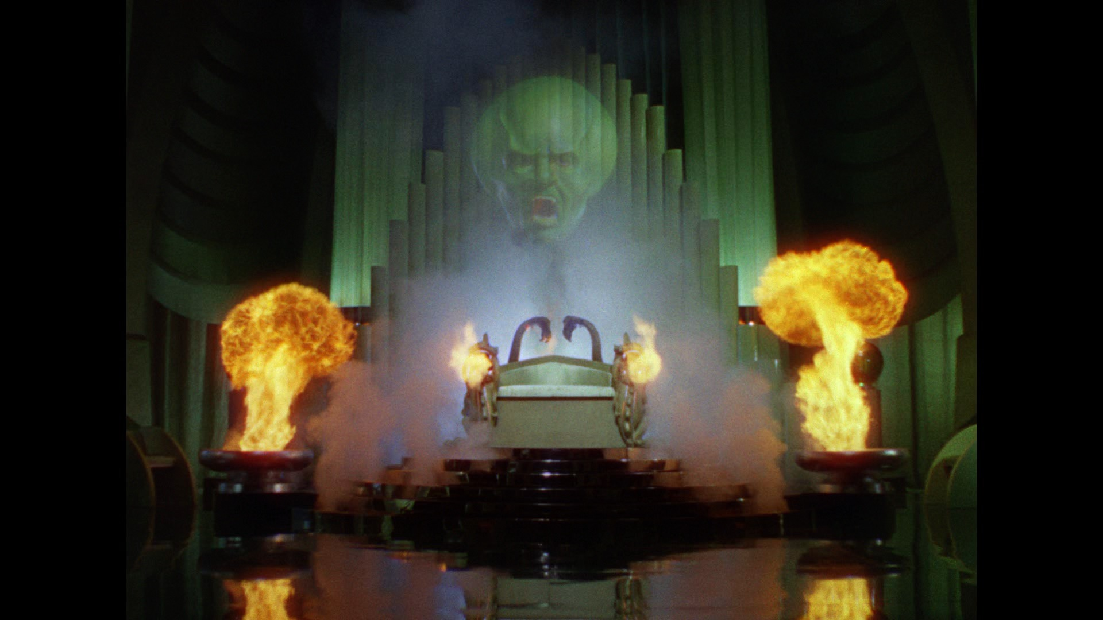

Slide 18
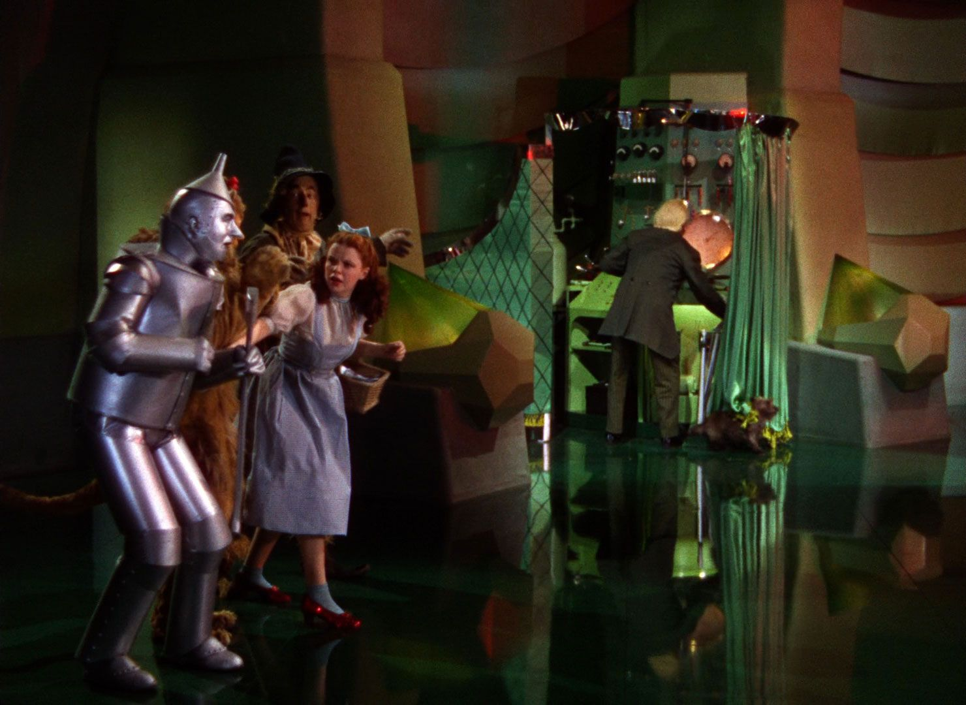

Slide 19
ILLUSTRATOR

Slide 20
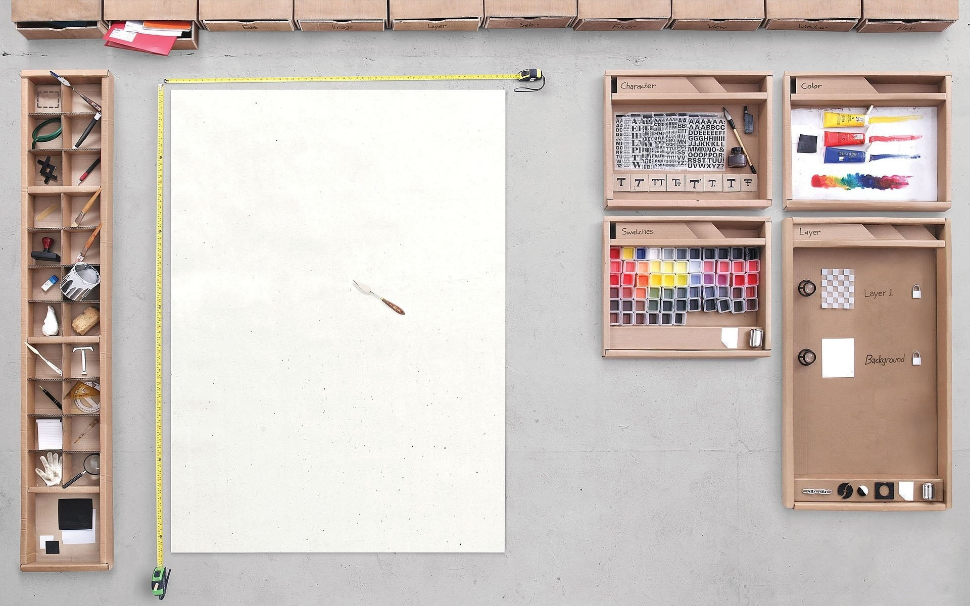

Slide 21
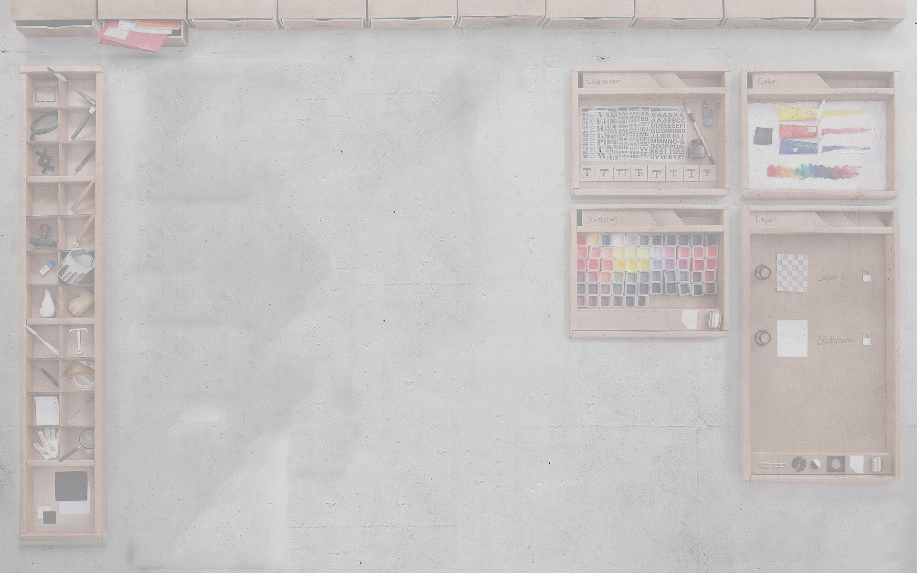


Document Files

Slide 22



Image Files

Slide 23


Editable IMage Files

Slide 24
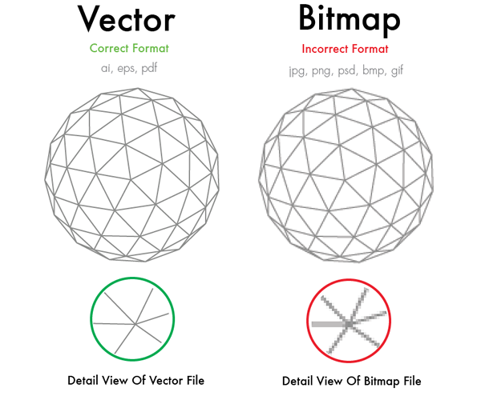

Slide 25
http://www.reggg.com/2013/02/real-life-photoshop.html

Slide 26
What You’re going to learn
Creating a board
Modifying board and its surrounding
Primary tools
Secondary tools
Font / Paragraph
Layers & how they interact
Creating shapes
Modifying shapes
Color, Stroke, Opacity, Properties
Path Finder
External Elements
Placing
Clipping masks
Saving document file
Saving image file
Packaging for external use

Slide 27

We’re NOT sponsored by Apple
I built my application on Windows 10 & Ubuntu
Seriously, we’re not

Slide 28
TONS OF RESOURCES

Slide 29


Slide 30
Search Terms
Vector
AI Icons
SVG Icons
Icon Set
Royalty free
FREE
[name] PNG Vector
[name] PNG Icon

Slide 31
PRE-MADE GRAPHIC TOOLS
Canva
https://www.canva.com/
GRAPHIC RIVER
https://graphicriver.net/
FREE VECTORS
http://www.freevectors.net/
Vecteezy
http://www.vecteezy.com/
… and a lot more

Slide 32
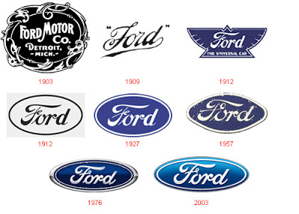
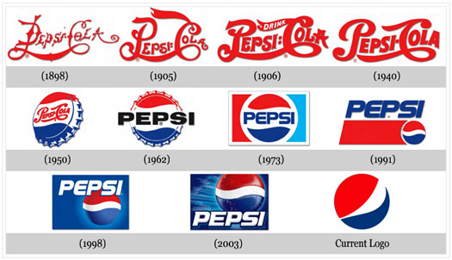
Everything Evolves

Slide 33
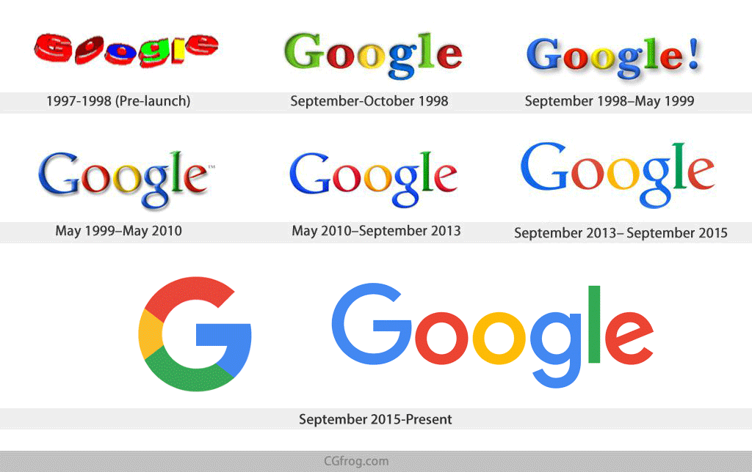
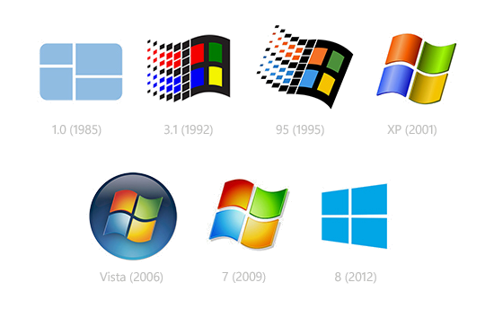

Everything Evolves

Slide 34
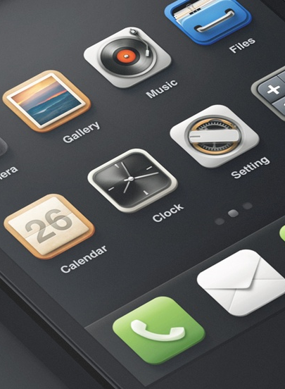
Keep In mind
THINK and PLAN before Designing
Keep it clean and simple
Go easy on the colors
Design what you NEED

Slide 35






KEEP IT CLEAN AND SIMPLE

Slide 36



Things can go bad real fast

Slide 37
SOME DEV ADICE

Slide 38
DESIGN FIRST
CODE LATER

Slide 39

Application Prototyping
www.sketchapp.com
Resources: www.sketchappsources.com

Slide 40


Online Prototyping
www.invisionapp.com
app.moqups.com

Slide 41
READ
PRACTICE
READ
HUSTLE

Slide 42
HUSTLE HARD
Notes:
Note about Sarah, beginner to hired

Slide 43
KEEP CODING
Have one project were you do EVERYTHING from scratch

Slide 44
KEEP READING
seriously

Slide 45
BACKRUB! - GOOGLE
Notes:
Note about Sarah, beginner to hired

Slide 46
ROYALTY FREE PHOTOS
https://picjumbo.com/
https://www.pexels.com/
https://unsplash.com/

Slide 47

You’ve gained a new skill

Slide 48
BONUS
HOW TO VERTICAL ALIGN with CSS

